Slide 1
Integer Representation
Only have 0 & 1 to represent everything
Positive numbers stored in binary
e.g. 41=00101001
No minus sign
No period
Sign-Magnitude
Two’s compliment
Notes:
<number>

Slide 2
Sign-Magnitude
Left most bit is sign bit
0 means positive
1 means negative
+18 = 00010010
-18 = 10010010
Problems
Need to consider both sign and magnitude in arithmetic
Two representations of zero (+0 and -0)
Notes:
<number>

Slide 3
Two’s Compliment
+3 = 00000011
+2 = 00000010
+1 = 00000001
+0 = 00000000
-1 = 11111111
-2 = 11111110
Notes:
<number>

Slide 4
Benefits
One representation of zero
Arithmetic works easily (see later)
Negating is fairly easy
3 = 00000011
Boolean complement gives 11111100
Add 1 to LSB 11111101
Notes:
<number>

Slide 5
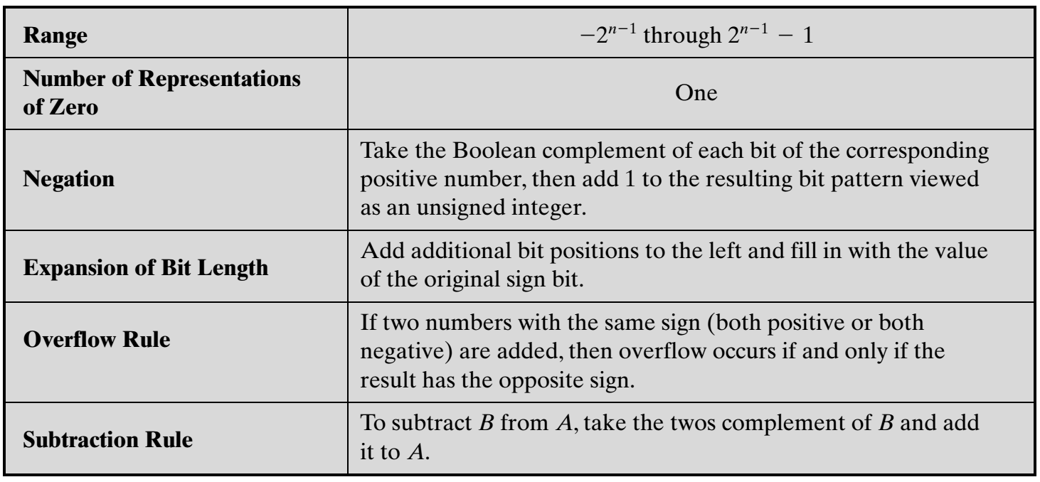

Slide 6
Negation Special Case 1
0 = 00000000
Bitwise not 11111111
Add 1 to LSB +1
Result 1 00000000
Overflow is ignored, so:
- 0 = 0 √
Notes:
<number>

Slide 7
Negation Special Case 2
-128 = 10000000
bitwise not 01111111
Add 1 to LSB +1
Result 10000000
So:
-(-128) = -128 X
Monitor MSB (sign bit)
It should change during negation
Notes:
<number>

Slide 8
Range of Numbers
8 bit 2s compliment
+127 = 01111111 = 2⁷ -1
-128 = 10000000 = -2⁷
16 bit 2s compliment
+32767 = 011111111 11111111 = 2¹⁵ - 1
-32768 = 100000000 00000000 = -2¹⁵
Notes:
<number>

Slide 9
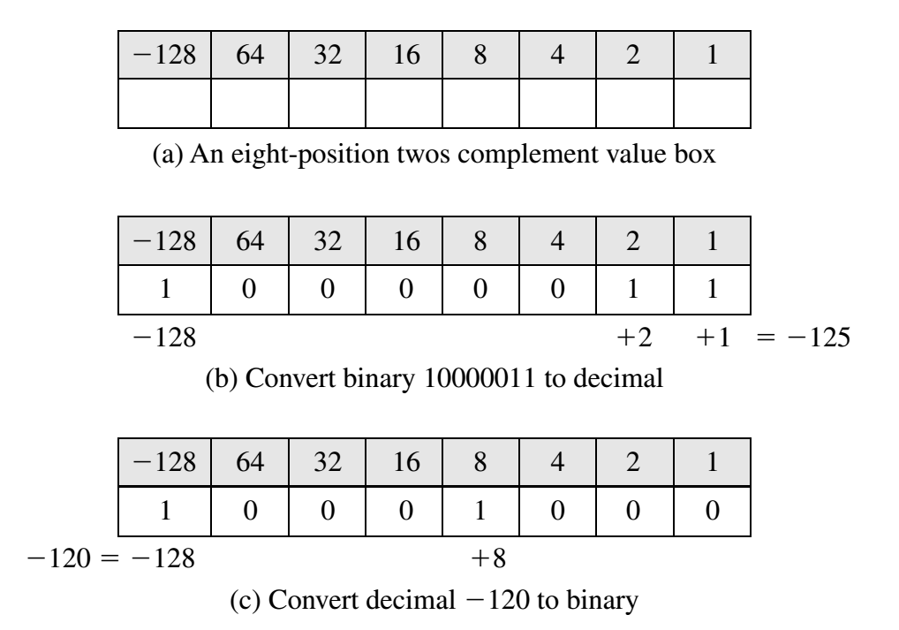
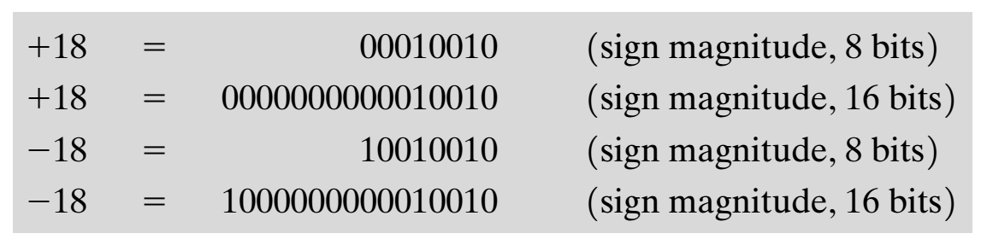
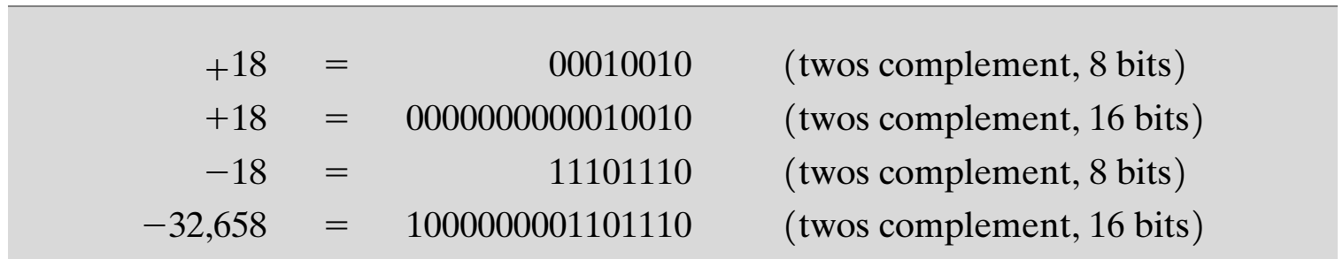
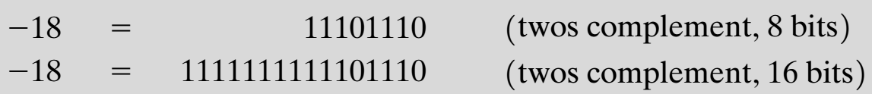
Conversion Between Lengths
If an n-bit integer is required to be stored in m bits, in sign-magnitude notation, this is easily accomplished: simply move the sign bit to the new leftmost position and fill in with zeros.
This procedure will not work for twos complement negative integers. Using the value box for conversion,
Use of a Value Box for Conversion between Twos Complement Binary and Decimal
Instead, the rule for twos complement integers is to move the sign bit to the new leftmost position and fill in with copies of the sign bit.

Slide 10
Addition and Subtraction
Addition
Normal binary addition
Monitor sign bit for overflow
Subtraction
Take twos compliment of substrahend and add to minuend
i.e. a - b = a + (-b)
Notes:
<number>

Slide 11
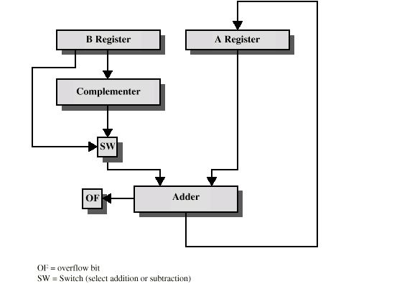
Hardware for Addition and Subtraction

Slide 12
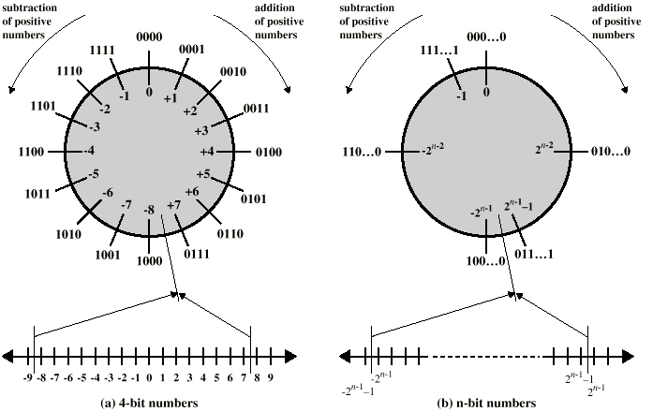
Geometric Depiction of Twos Complement Integers

Slide 13
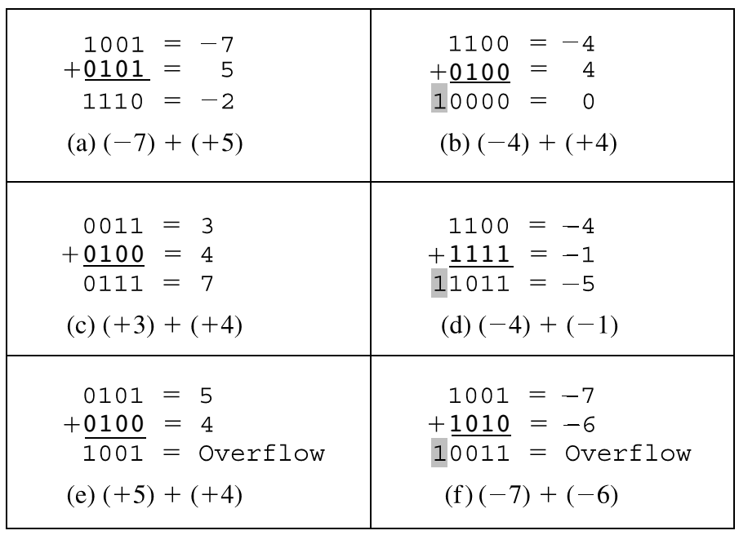
Overflow rule
If two numbers are added, and they are both positive or both negative, then overflow occurs if and only if the result has the opposite sign.Figures (e) and (f) show examples of overflow. Note that overflow can occur whether or not there is a carry.

Slide 14
Problems
Represent the following decimal numbers in both binary sign magnitude form and twos complement form using 16 bits: +512, -29.
Sign Magnitude:
512 = 0000 0010 0000 0000
–29 = 1000 0000 0001 1101
Two’s Complement:
512 = 0000 0010 0000 0000
–29 = 1111 1111 1110 0011

Slide 15
Problem
Represent the following twos complement values in decimal: 1101011; 0101101.
1101011: Because this starts with a leftmost 1, it is a negative number. The magnitude of the negative number is determined by flipping the bits and adding 1:
0010100 + 1 = 0010101
This is 21, so the original value was –21.
0101101
Because this starts with a leftmost 0, it is a positive number and we just compute the magnitude as an unsigned binary number, which is 45.

Slide 16
Problem
3. Assume numbers are represented in 8-bit twos complement representation. Show the calculation of the following:
a. 6+13 b. -6+13 c. 6-13 d. -6-13
Do c and d yourself
+6 00000110
–13 11110011
–7 11111001
–6 11111010
–13 11110011
–19 11101101
Practice with more problems

